Slide 1
NoSQL Database
Cindy Chen

Slide 2

How did you choose that topic?
I choose NoSQL as its increasing in functionality, popularity, and usage by many tech companies.
NoSQL has offered more performance and functionalities that traditional RDBMS
Interested in learning more for its strength, scalability, and more knowledge

Slide 3

How has researching the subject improve your knowledge in the domain of database systems
Researching more into NoSQL offered traditional vs non-traditional knowledge in similarities and differences in database functions and capabilities.
I understand more based on types of databases to use depending on the main functions
I understand the pros and cons of traditional RDBMS compared with modern NoSQL
It increased my knowledge on NoSQL

Slide 4
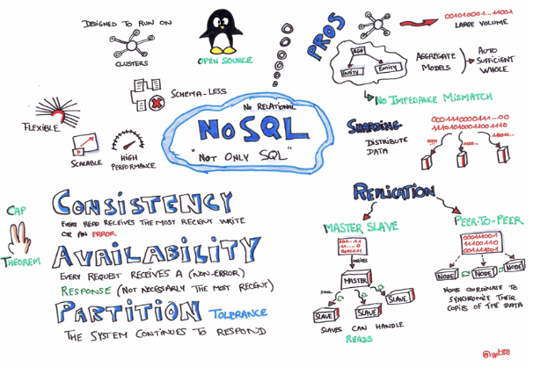
NoSQL: knowledge foundation
NoSQL is the more modern, advanced in the database platforms.
NoSQL provides database more flexibility, scalability, and better consistency with high volumes of data.
NoSQL stands for “Not only SQL”.
NoSQL has increased in demand due to the horizontal scalability, efficiency in storage, and greater availability in retrieval of data.
NoSQL is great in ways of non requiring non-strict schema approach, data efficiency, and handles failures independently.

Slide 5
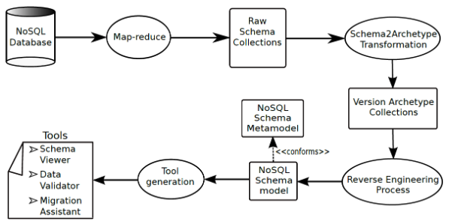
NoSQL doesn’t require schemas
NoSQL doesn’t require schemas as compared to traditional RDBMS.
Defining a schema for NoSQL is optional, this allows users to store many structures of data within the same database.
NoSQL allows greater flexibility, tolerance, and compliance.

Slide 6
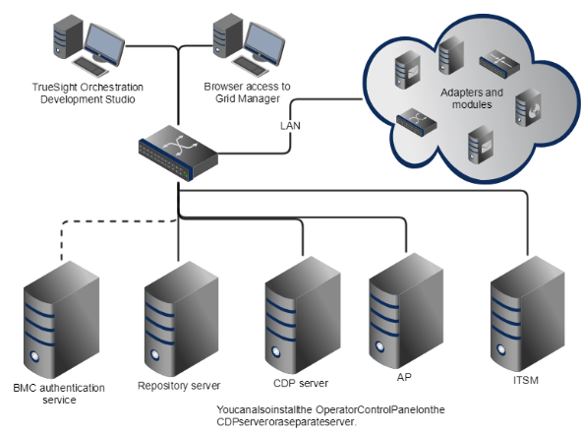
NoSQL provides high scaling abilities.
NoSQL storages data across multiple machines and servers.
As compared to traditional RDBMS, upgrading of the hardware is needed whenever data increases to its limit.
NoSQL stores data in different machines and servers, allowing users to store across numerous servers automatically

Slide 7

NoSQL handles server failures independently
NoSQL manages databases on different machines and servers. When one server fails, the failure is independent from other servers.
NoSQL provides horizontal scalability, allowing othe servers to continuously work in default nodes.
NoSQL guaranteed that a single point of failure doesn’t affect the overall performance of the database

Slide 8






Popular NoSQL databases
MongoDB
Cassandra
Redis
Hypertable
CouchDB
More….

